Slide 1
Home automation to save energy
Smart home

Slide 2
Team of project
Level 3 Bioinformatics
Mostafa Gamal Mostafa.
Ahmed Omar Mohamed.
Hamza Ashraf Mostafa.
Omar Mohamed elyamany

Slide 3
Project idea
To introduce a new automated system to control it while being outside home

Slide 4
Business need
The project will target 100 workers and 20 managers And employment will increase with the passage of years.
Each house will need workers and managers or engineers to repair any problems.

Slide 5
The budget
■ The initial projected: $100,000
■ five sensors : one = $200 total = $1000
■ 2 developers: 24,000$
■ Electronics Engineer: 5,000$
■ 6 new computers: 12,000$
■ training for our team: 3000$
Total funds we spent until now: 45,000$

Slide 6
project Resources
Wikipedia
Google search

Slide 7
Deliverables
advantages of home automation system
convenience:- Managing all of your home devices from one place. Being able to keep all of the technology in your home connected through one interface is a massive step forward for technology and home management
Higher quality of life:- Since smart homes allow you to adjust everything from just one single device, chances are that also your overall quality of life will increase.
Smart homes may be suitable for disabled persons:- Also for disabled persons, smart homes may be a great tool to facilitate their lives.
for instance, if you sit in a wheelchair, you will not be able to use staircases.
Thus, if you want to control devices in other rooms, you may be stuck in a conventional home since you will not be able to reach those devices

Slide 8
advantages of home automation system
Cost savings in the long run:- Since you can save large amounts of energy through the use of smart home technologies, you can also save plenty of money in the long run.
Energy prices will likely increase in the future due to the energy transition process towards alternative energies and therefore, it might be crucial to save some energy since those energy savings may translate into significant money savings.
.Support for the older generation:- Smart homes can also be a great way to facilitate the life of our older generation.
for instance, with smart homes, you can simply open the door with your voice without even needing a key to get in.
thus, since old people often don’t find their keys anymore, it may be a great help to open the door with their voice instead of having to search for the key.
moreover, old people often also have difficulties to walk upstairs due to their weak physical condition.

Slide 9
advantages of home automation system
Energy savings:
Smart homes can also help you to save plenty of energy.
for instance, when you heat your home in winter with conventional heating devices, chances are that you will either heat too little or too much since it is quite hard to sustain an optimal temperature inside with those old devices.
however, by using smart home technologies, chances are that your heating will keep the temperature inside at a constant level.
therefore, smart energy devices can avoid excessive heating and help you use the heat as efficiently as possible.
this is not only true for heating, but also for air conditioning and other devices that could consume large amounts of energy.

Slide 10
disadvantages of home automation system
Reliable internet connection is crucial:
Another downside of smart homes is that they need a reliable internet connection to work properly.
Security issues :
there might also be some security issues associated with smart home technologies.
for example, burglars could hack into your smart home system and open the lock in order to get access to your home.
moreover, hackers may also steal your data

Slide 11
disadvantages of home automation system
Some people may not like smart technologies:
-Many people also just don’t like the idea of a smart home.
-Especially the older generation is often quite skeptic about it.
-Since we often hear about weaknesses of those systems which make it easy for burglars to get into our home, many people may refrain from those smart home technologies and rather rely on their old-school locks, even if those locks are also quite unsafe.

Slide 12
disadvantages of home automation system
Some initial learning efforts necessary:
even if the smart home system works properly, there is still some learning required from your side in order to manage your home from just one single device. In the first days, you might feel a little bit overwhelmed.
Smart home technology not suitable for all houses:
Depending on how old your house is, it may not even be suitable for smart home technologies since those technologies often require a certain wiring and many old buildings do not have proper wiring in this regard.
Thus, before you decide to install smart home devices, make sure that your home is actually suitable for it

Slide 13
the time that we need to develop the project.
we will need three months or four at least but the time will be increased if there are more updates in the project as Covering all the facilities and houses.

Slide 14
The scope :
project objective:- Home automation helps increase the comfort level of the homeowner. With home automation, the homeowner can have full control over their homes from anywhere.
Time scope:- The study was conducted for a period of Three months from January to March 2021 from the stage of analysis, data collection and system development, for the purpose of gathering valid information to enable us to develop the system.

Slide 15
The scope :
The initial cost:- the initial cost of setting up the system will include the cost of hardware software (OS, add-on software , training)&labor(setup & maintenance).the same has to bear by the organization

Slide 16
The scope :
Technical requirements
Hardware requirements:-
Mobile phones
Sensors
Smart device management software and systems
Surveillance cameras
Electronic locks3- Fire Alarms
Anti-theft Alarm System
Software requirements:-
Java and flutter to develop the application .
Customer reviews
This application made me comfortable and saved me time and effort.

Slide 17
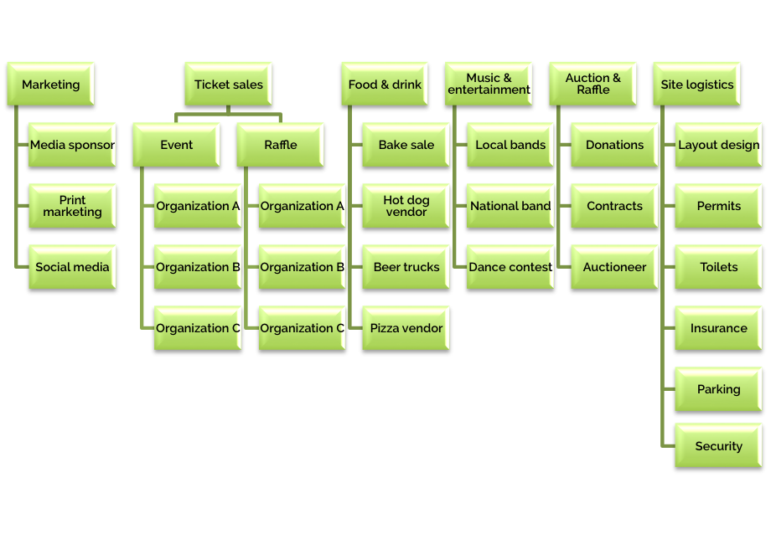
WBS

Slide 18
Risks:
One of the problems with smart home systems is that there are very few globally accepted industry standards that fit smart home systems, and poor calibration (standardization) and use of proprietary technology can cause problems for owners who want to automate their homes. Without industry standards, a person might invest in an entire system that is unable to communicate efficiently with all devices.
One of the disadvantages of the smart system is also the possibility of being hacked and hacked. A Microsoft research in a 2011 study found that the reason is the rigidity of interconnected devices and sometimes the high cost of ownership. The most likely customer would trust a single vendor to purchase an integrated system, often with proprietary equipment, although it has been shown that open source software can be used to hack proprietary equipment.
Most smart devices depend on the Internet connection, and if it is interrupted, the interface of the smart system will be disrupted. Sometimes also, communication via wireless signals (the most economical way to communicate items) may be subject to interference with various signals from another person causing them to not function properly.

Slide 19
Monitoring:-
The design of a smart green environment of home automation for appliances monitoring systems is developed based on an IoT(Internet of Things) application. The smart home concept represents a motivating platform for innovation of information technology services to produce more operative house devices and system that can improve the standard of life. This project aims at controlling home appliances via Smartphone using Wi-Fi as a communication protocol and the Raspberry Pi as a server system. The user here can move directly with the system through a web-based interface over the net. The designed system not solely monitors the sensor data but also actuates a process according to the need. Therefore, globally accessible automation of electronic appliances is created attainable with the utilization of a Raspberry Pi micro-controller board, a web affiliation and relay switches in a user-friendly way for the users to regulate home electronic appliances with high flexibility and security.

Slide 20
The project information for the Home automation to save energy is presented here :
ID | DESCRIPTION | Predecessor | Time
A | Requirement Gathering | None
B | Analysis | A
C | Design | A
D | Coding | B
E | testing | C,D
F | Implemented | D,E

Slide 21
Network Project:
 | B
 | D
 | A
 | F
 | C
 | E
ES | ID | EF
SL |  | SL
LS | DU | LF

Slide 22
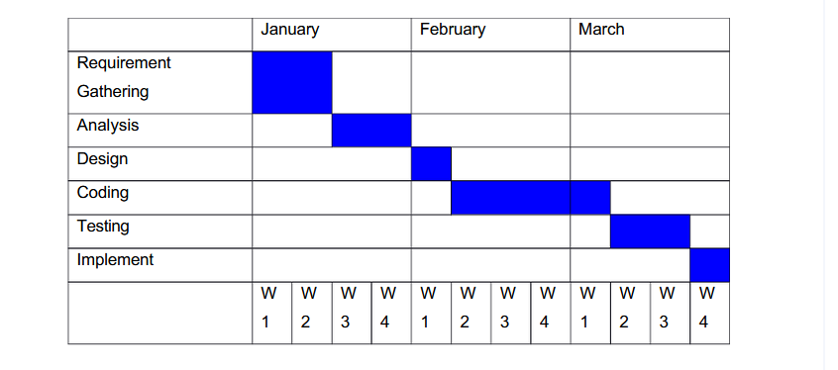
Gantt chart:

Slide 23
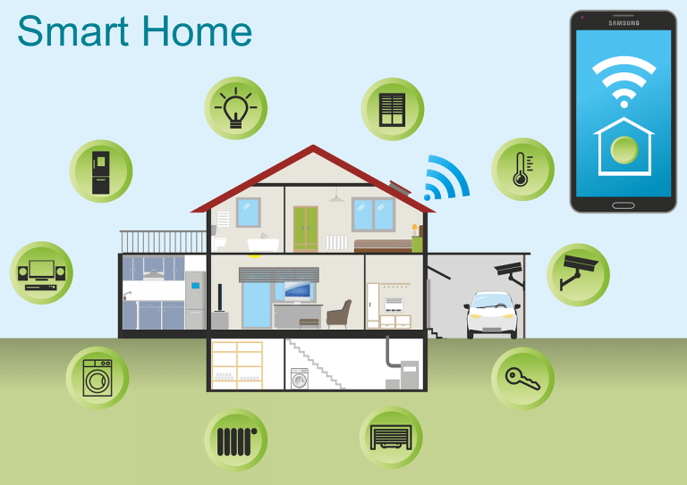
An illustration of what the user controls the smart home

Slide 24
The sponsor
-“ TOSHIPA COMPANY” is the Sponsor of our project .
-It is an advanced technology company.

